Slide 1
Resilience Function

Slide 2
FaaS Limitation
Low performance East/West communication:
North/South function call
Central storage: Event Queue, S3
Low performance storage
Lifetime limitation: 15 min
No orchestration
Can
Stateless short life task
Declarative Workflow
External Orchestration
Durable
Can’t
Bigdata
AI processing
Micro-service

Slide 3
Goal
Vision
Scope
High performance Serverless for all computation workload
Unified platform: FaaS, Bigdata, AI, Microservice
High resource utilization: Online/Offline workload mixed deployment
High performance: Speculation, no commit wait
New technique: RDMA, NVMe-oF
On-demand resource allocation
Bigdata
Batch
Streaming
Interactive
AI processing
Stateless Microservice
Challenge
Motivation
Short lift-time vs Long live orchestration
Low performance storage
No East/West communication
Durable: Durable orchestration function
Resilience: Spark RDD (Resilience Distributed Dataset)
Checkpoint/Reply: Flink fault tolerance, Orleans Stateful Actor
DNS Service Discovery/Autoscaling/…: Kubernetes
State-of-the-Art techniques: RDMA, NVMe-oF

Slide 4
Resilience Function
Resilience Programming
Function
Function call
Async Programming
Resilience Object (Blob/Event Queue)
Programming Language Agnostic
Stateless Microservice
Function-name-based service discovery
Kubernetes microservice compatible
Serverless style autoscaling
Computation
On-demand
Resilience
Speculation
Durable
Online/Offline Mix Schedule
Storage
Ephemeral/Unreliable
High performance
Blob, Event Queue, K/V
SPDK NVMe-oF
Multi-tenant
Network
Multi-tenant East-West
Func Call Optimization
Transport Layer AuthN/AuthZ
Network Layer Encryption
RDMA

Slide 5
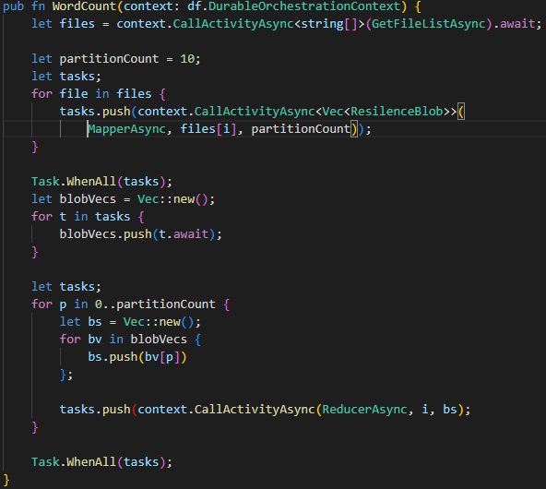
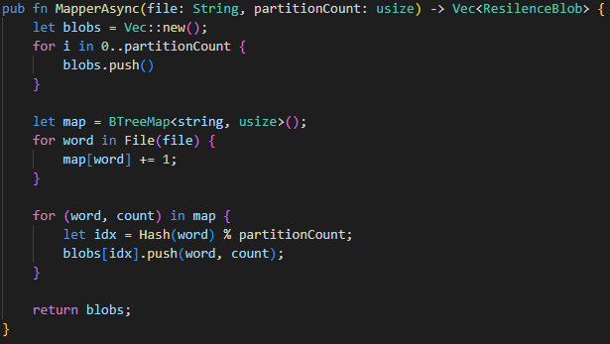
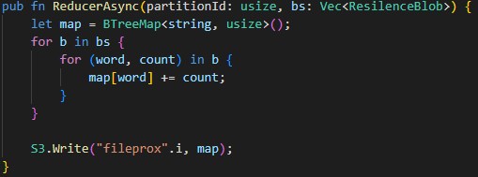
Map-Reduce Example (Runtime only, No optimization)

Slide 6
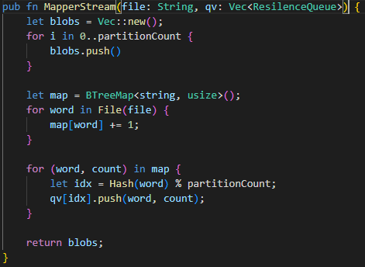
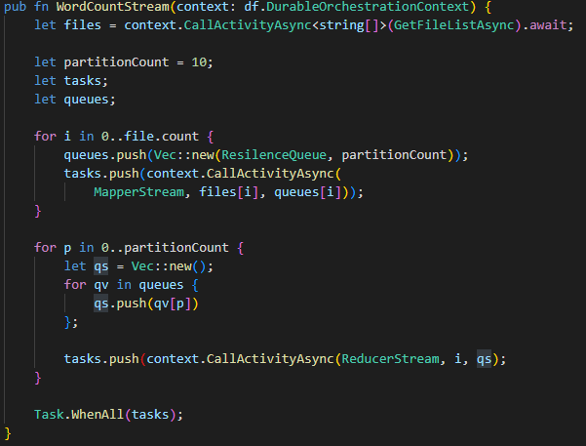
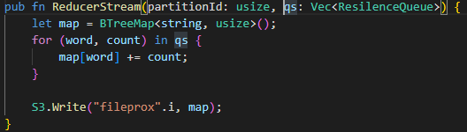
Map-Reduce Stream Example

Slide 7
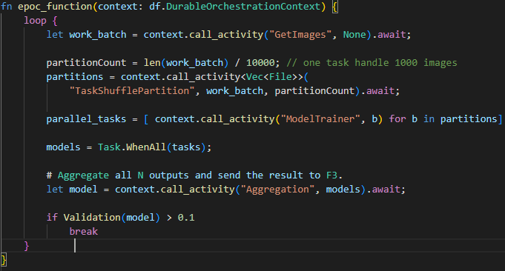
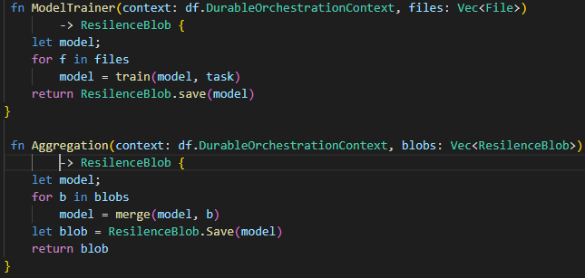
AI Example

Slide 8
Architecture
Key Techniques
Resilience Orchestration:
Speculation
Resilience
Durable
East/West communication
Function Bus: Async Call
Addressable worker
Replay-able message queue
Intra-Cluster RPC: Sync call (Http/gRPC)
DNS based service discovery
Event Queue: Streaming
Reliable/Unreliable
Reply-able
Exactly once/Offset
Resilience Storage: Blob, K/V
State-of-the-Art techniques: RDMA, NVMEoF
Storage Program Interface: Blob, Queue, K/V
Unreliable: High performance ephemeral cluster local
Reliable: Central storage (S3, DynamoDB, Kafka)
Stateless Function
Stateful Function
Orchestration Function
Cluster Manager
Func Bus/RPC/Event Queue
Central Storage
Key/Value, Blob, Queue
Resilience Storage
Key/Value, Blob, Queue
API Gateway
Orchestration Service
Service Broker
Components
Service Broker:
Pod lifetime management: Start/Eviction/Checkpoint
Route Message/Request
Orchestration Service:
Orchestration function input/output proxy
Orchestration function state management
Cache: K/V, Blob, Queue
Gateway:

Slide 9
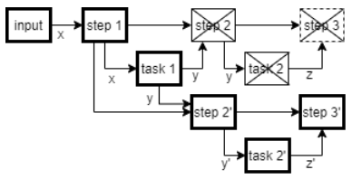
Resilience Orchestration -- opportunity
Blob X1
Map1
Blob Y1_1
Reduce1
Blob Z1
High-cost fault tolerance:
Reliable low performance storage
Commit before next step
Opportunity
Unreliable high-performance storage
No commit wait
Solution: Resilience Orchestration
Speculation
Rerun
Failures
Task fail
Orchestrator function fail
Control plane fail
Data missing
Blob Y1_2
Rerun
Blob Y2_1
Blob X2
Map2
Reduce2
Blob Z2
Blob Y2_2
X

Slide 10
Resilience Orchestration -- Design
Orchestration Task
Task A1
Blob I1_1
Task C1
Blob X1
Blob I1_2
Blob K1
Persistent Store
Orchestration Service
Blob X2
Task A2
Blob I2_1
Task C2
Blob K2
Blob J2_2
Task E1
Blob Y1
Speculation:
Ephemera Storge: Blob/Event Queue
Control plane: No commit wait
Tables:
Task table
Task → <Input, Output>
Blob table
Blob → Source Task
Complete Task
Pending Task
Running Task
Retrospect prune
Keep all intermediate data until job done?
Prune: Reliable storage of intermediate data
Reliable/Unreliable Storage Program Interface
Rerun
X
Blob Y1
Task B1
Blob J1_1
Task D1
Blob L1
Task E2
Blob Y2
Blob J1_2
Rerun
X
Task B2
Blob J2_1
Task D2
Blob Y2
Blob J2_2
Blob L2
Task | Input | Output
Task D1 | BlobJ1_1, BlobJ2_1 | BlobL1
Task B2 | Blob Y2 | BlobJ2_1, BlobJ2_2

Slide 11
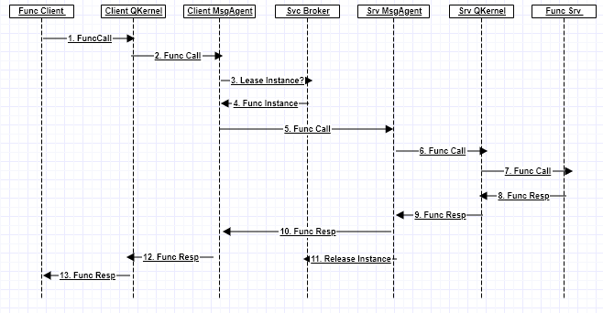
Message Bus
Worker Node
Worker Node
Quark Container
Func Agent
Quark Container
Func Agent
Quark Pod
…
Quark Pod
RDMA Service
RDMA Service
RDMA
Service Broker
…
Service Broker
TCP
Cluster Manager
Mode
Reliable Datagram
Maximum 128KB
Function name convention
[Node ID]
Project name
App name
App instance name
Worker name
Worker instance

Slide 12
Intra-Cluster RPC(e.g., http/gRPC)
Core DNS
Cluster Mgr
Goal: run existing stateless microservice as function
Components:
Core DNS: multitenant DNS
RDMA Service: multitenant Srv IP mapping
Relay Broker:
TCP/Http/gRPC Proxy
Func instance lifetime mgr
Encrypt/P2P authN
RDMA svc transport layer encrypt
RDMA srv authN
a. Func2 -> 123.1.2.3
d. Start Func2 instance
e. New Func2 10.5.66.3
Quark Pod 1
(Function 1)
Relay Broker
Tenant 0: 10.4.5.6
Quark Pod 2 (Function 2 10.5.66.3)
b. Connect 123.1.2.3:80
f. Connect Tenant1: 10.5.66.3:80
g. Connect 10.5.66.3:80
RDMA Service
RDMA Service
RDMA Service
c. Connect Tenant0: 10.4.5.6: 789
Tenant1: Function1 Connect Tenant1: Function 2
DNS: Func name to service IP resolve
Client connect svc EP (IP: port)
RDMA Svc connect svc EP through srv broker EP
Svc Broker call start cluster Mgr new Func2 instance
Cluster Mgr start new Func2 instance 10.5.66.3
Relay Broker connect tenant1: 10.5.66.3:80
RDMA Svc connect tenant1: 10.5.66.3:80

Slide 13
Proposal Plan
Stateless async function: 4/30
Durable/Service 2 Service RPC: 7/30
Resilience batch job (Storage): 11/30
Streaming job
Interactive job

Slide 14
Fu
SendBuf
QStream
(Buf Queue)
hasWriteDataNotify
Func Library
canWriteNotify
canReadNotify
Function Client
RDMAChannel
QStream
TCPStream (No authN)
RDMAChannel

Slide 15
Node 1
Node 2
Quark Pod/ Gateway
Msg Agent
Svc Broker
Cluster Mgr
Msg Agent
Quark Pod
Msg Call
Msg Call
Start Pod
Start Pod Response
Start Pod
Msg Call
Connect / Ask Request
Msg Call
Msg Resp
Msg Resp
Msg Resp

